Slide 1

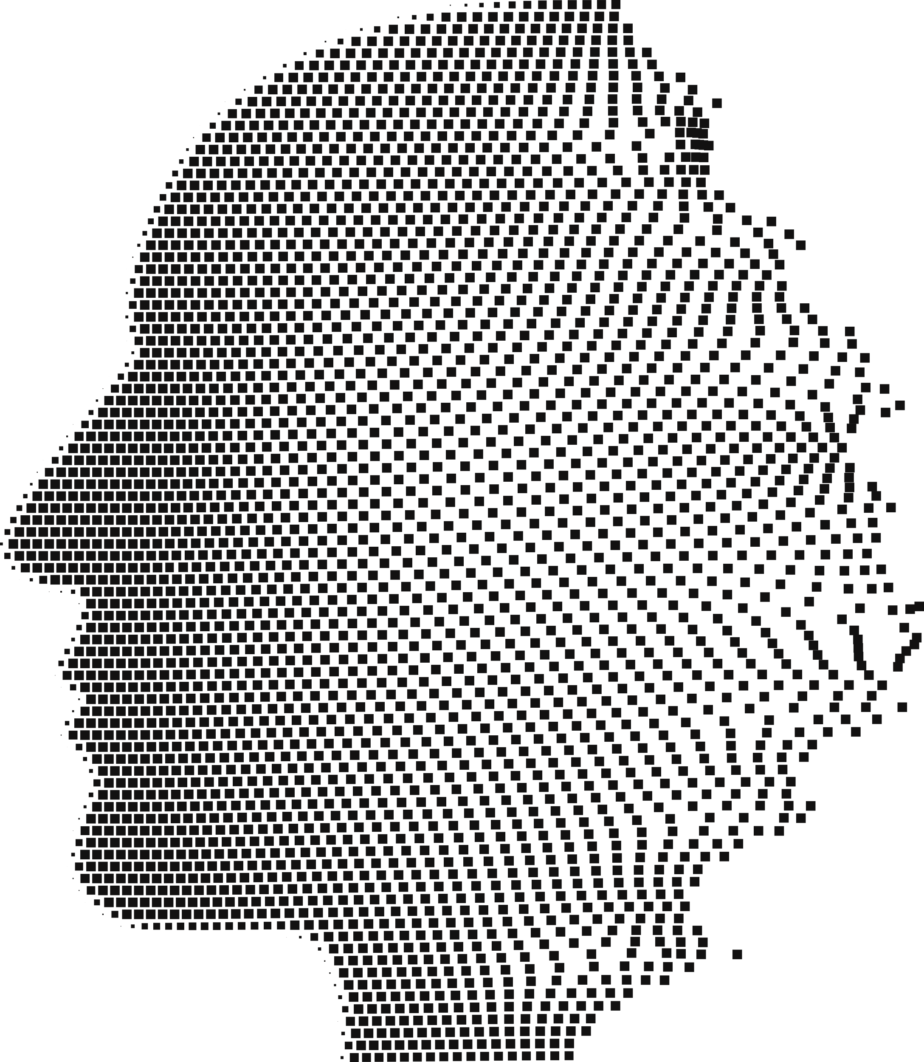

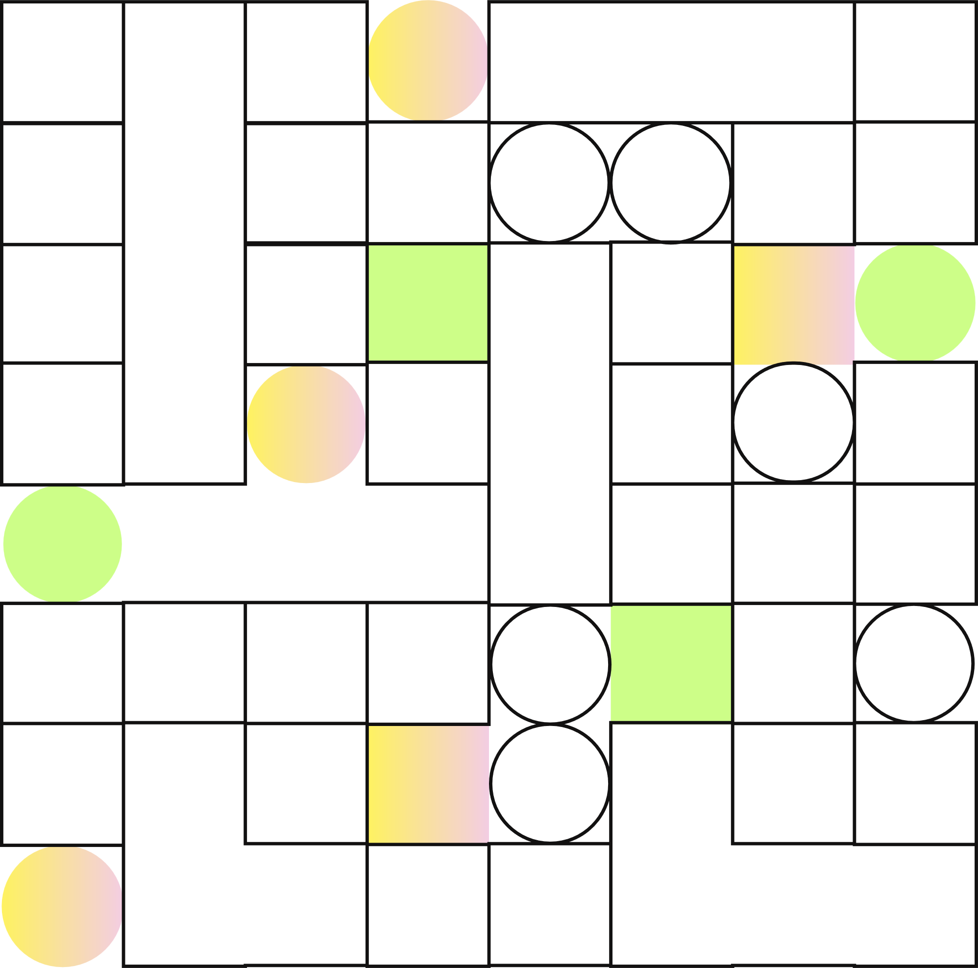

FIRST REVIEW
Object Detection and Person Tracking
in Combat Zones using Kalman filtering
FEB 2025

Slide 2
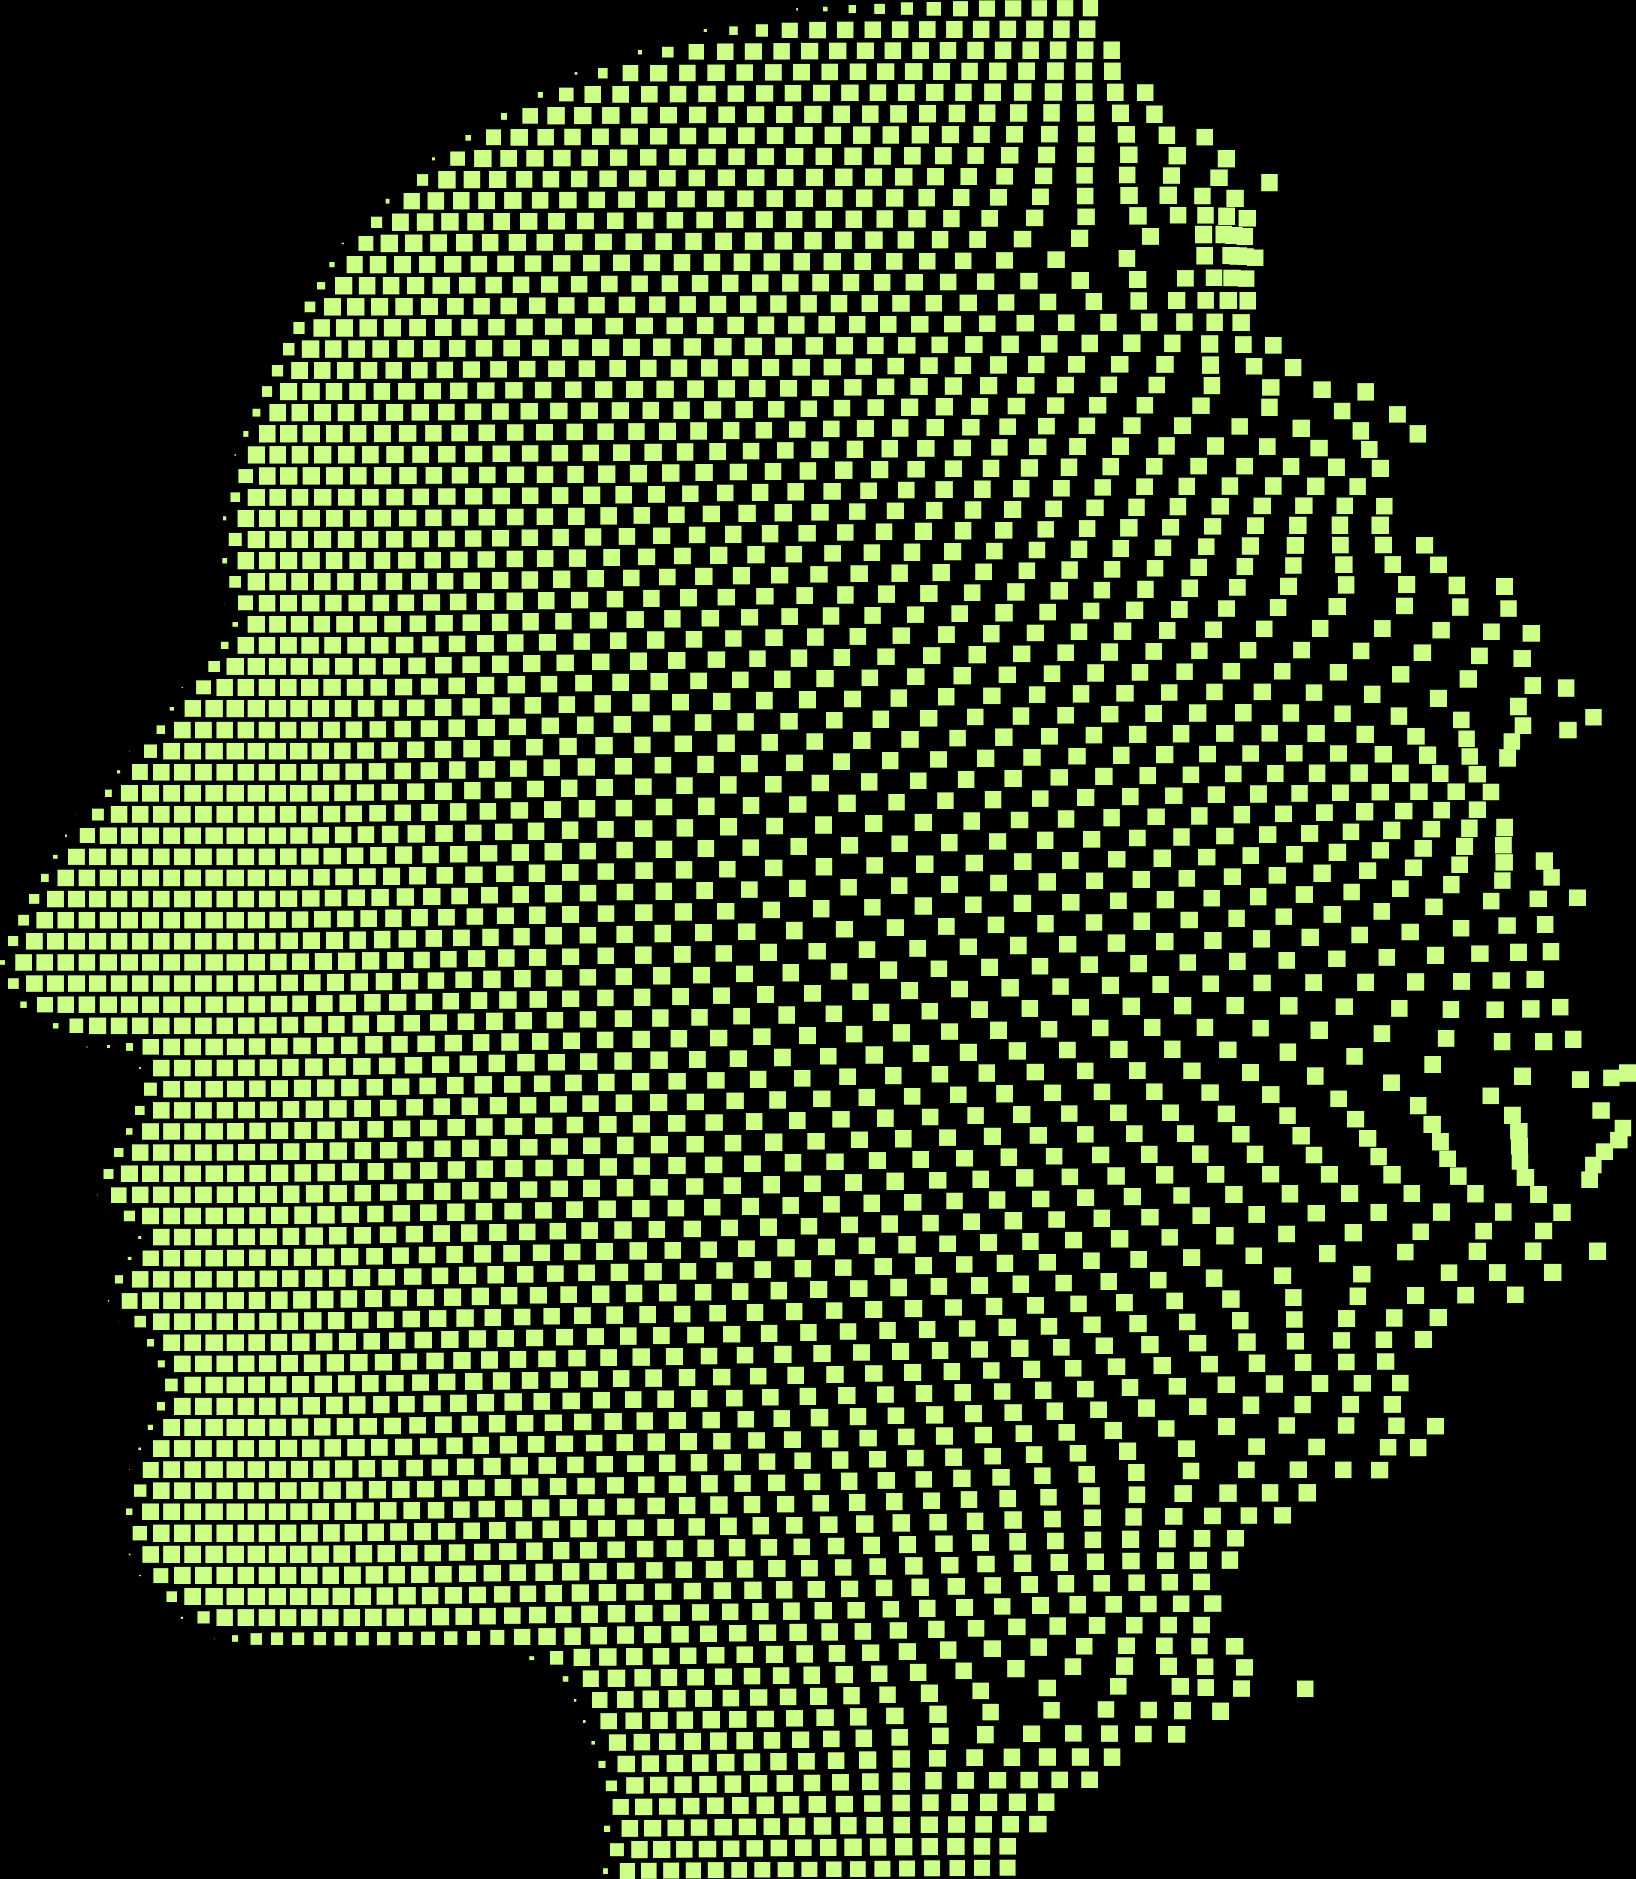
Welcome to the Presentation
CB.SC.U4AIE24023 - Kiruthikpranav
CB.SC.U4AIE24038 - Maniroop
CB.SC.U4AIE24026 - Sasank Gupta
CB.SC.U4AIE24060 - Vikram

Slide 3


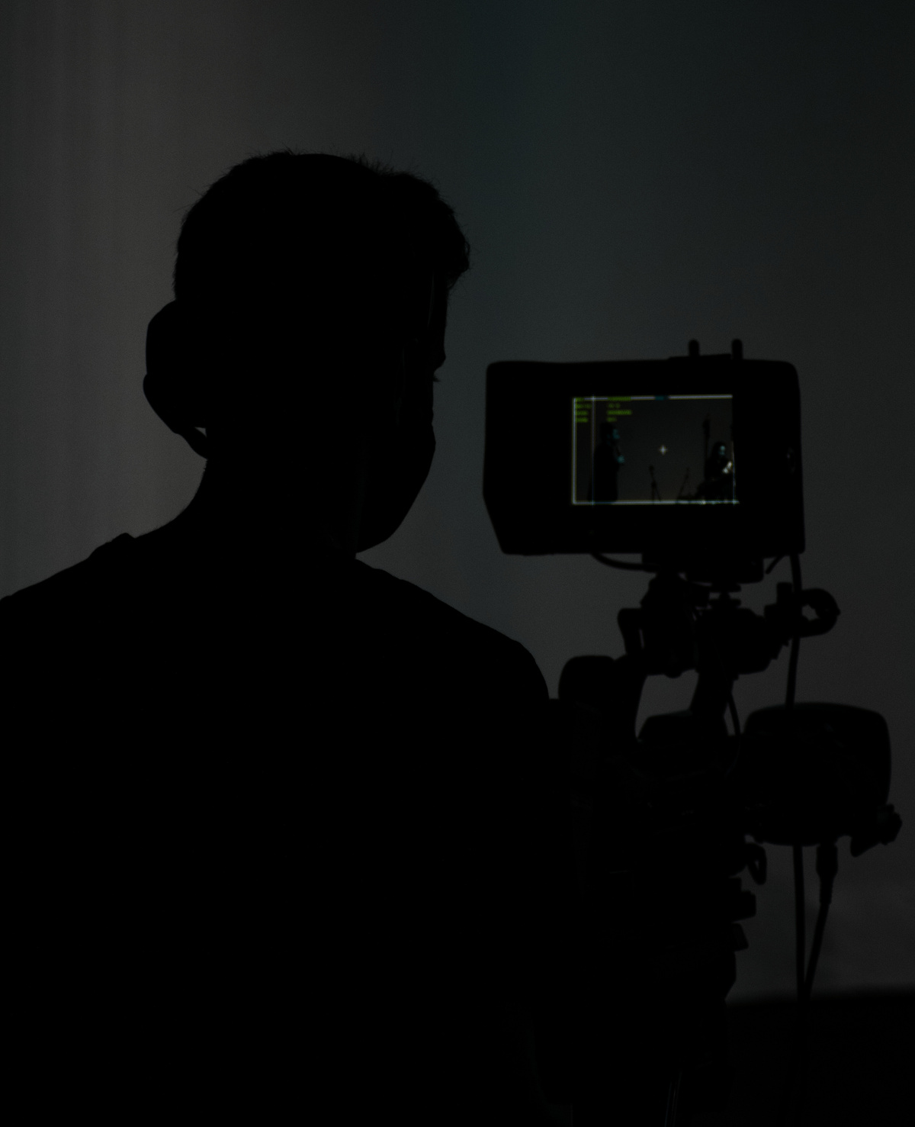
2
Overview
Introduction to Object Tracking
Timeline
1
3
Literature
Review

Slide 4



INTRODUCTION TO
Object Tracking
Advantages & Real-time Applications
High Accuracy: Uses YOLOv8 for precise detection.
Real-time Tracking: Implements Kalman Filters for smoother object tracking.
Robust Performance: Handles occlusions, motion blur, and rapid movements.
Applications
Autonomous drones for surveillance.
Smart battlefield monitoring.
Intruder detection in restricted zones.
Limitations
Computationally Intensive: Requires high-performance GPUs.
Environmental Factors: Performance may drop in low-light or extreme weather.
False Positives: Risk of misidentifying objects in complex environments.

Slide 5
Efficient Object Detection
Objective
Implement real-time object tracking using YOLO to accurately detect and identify targets in dynamic environments
Effective Tracking in Combat Zones
Enhance tracking performance in challenging conditions such as occlusions, low visibility, and rapid movements
Optimized Computational Performance
Ensure efficient processing with minimal latency to enable real-time decision-making
Integration with Mathematics
Integration of Mathematical Models with Kalman Filtering for Enhanced Tracking Accuracy

Slide 6

Literature
Review

Slide 7
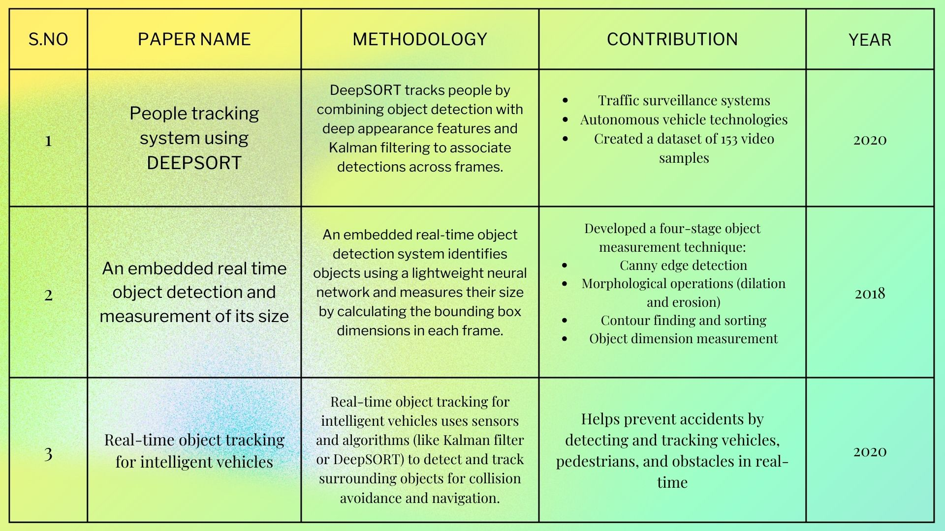

Slide 8
Methodology
Data Collection – Gather video datasets from combat simulations or real-world scenarios.
Preprocessing – Enhance frames by denoising, resizing, and normalizing for efficient processing.
Object Detection – Utilize YOLO for real-time detection of objects and persons in combat zones.
Tracking Mechanism – Implement Kalman filtering to predict and track object movement.
Optimization – Fine-tune the model for accuracy, robustness, and real-time performance.
Evaluation – Measure tracking accuracy, speed, and efficiency using benchmark metrics.

Slide 9
Datasets
VisDrone Dataset – Aerial surveillance videos with objects like vehicles, pedestrians, and military equipment.
UAVDT (Unmanned Aerial Vehicle Detection and Tracking) – Contains drone-captured videos for object detection and tracking.
MOT Challenge (Multiple Object Tracking) – Benchmark dataset for person and vehicle tracking in real-world environments.
DOTA (Dataset for Object Detection in Aerial Images) – High-resolution images with annotated combat-related objects.
KITTI Dataset – Useful for autonomous tracking of vehicles and pedestrians in dynamic environments.

Slide 10
Metrics
Evaluations Conducted on a custom dataset. Metrics indude tracking reliablity, response time, and stability of tracking under dynamic conditions.
Experimental evaluation involved measured objects (height and width) under varying conditions, with detailed accuracy Comparisons across multiple trials
Testing revealed different performance levels across YOLO versions

Slide 11
Limitations
Occlusion Issues – Objects may be temporarily blocked by obstacles, reducing tracking accuracy.
Lighting and Weather Conditions – Low visibility due to fog, rain, or night-time conditions affects detection performance.
Computational Complexity – Real-time tracking requires high processing power, making deployment on edge devices challenging.
Similar Object Appearance – Soldiers, vehicles, or equipment with similar features can cause identity switching errors.
Sensor and Data Limitations – Limited availability of high-quality annotated datasets for combat-specific environments.

Slide 12
MATHEMATICAL APPLICATION
Kalman Filtering
Kalman filtering is an algorithm that estimates the state of a dynamic system from noisy measurements. It is widely used in control systems, robotics, signal processing, and finance
Mathematical Formulation:
State Equation (predicts next state):
xₖ = A xₖ₋₁ + B uₖ + wₖ
Measurement Equation (updates based on observations):
zₖ = H xₖ + vₖ
Applications:
Tracking (e.g., object tracking in video, radar tracking)
Robotics (e.g., localization, SLAM)
Finance (e.g., stock price prediction)
Signal Processing (e.g., noise reduction)

Slide 13

Gap in Study
While existing object tracking methods like YOLO and Kalman Filtering perform well in controlled environments, their effectiveness in dynamic and unpredictable combat zones remains a challenge. There is a lack of real-time tracking models specifically optimized for occlusion handling, rapid motion, and adverse conditions such as low visibility and cluttered backgrounds

Slide 14
Problem Statement
Need for Real-Time Tracking: Existing tracking systems struggle to provide real-time, accurate object tracking in combat zones.
Challenges in Combat Environments: Issues like occlusion, rapid movements, poor lighting, and cluttered backgrounds affect detection accuracy.
Limitations of Traditional Methods: Conventional tracking models fail to predict object motion effectively in dynamic scenarios.
Objective of the Project: Implementing YOLO with Kalman Filtering to enhance tracking accuracy, robustness, and real-time performance in combat zones.

Slide 15
Proposed Method
Object Detection (YOLOv8): Uses YOLOv8 to detect and classify objects in real-time combat scenarios.
Tracking (Kalman Filter): Predicts object movement and maintains tracking even during occlusions.
Detection-Tracking Integration: Assigns unique IDs to detected objects and updates their positions frame-by-frame.
Testing & Optimization: Evaluates system accuracy using real-world combat videos and optimizes for real-time performance.

Slide 16
Timeline
January - Mid February: Literature review, dataset collection, and initial experimentation with YOLO and Kalman Filtering.
Mid February - End February: Implementation of object tracking model, integration of Kalman Filtering, and performance evaluation.
March - Mid March: Optimization, testing in combat-like scenarios, and final improvements.
Mid March - End March: Paper writing, documentation, and preparation for conference submission.

Slide 17
Conclusion
This project successfully implements real-time object tracking in combat zones using YOLO and Kalman Filtering. The system enhances tracking accuracy by predicting object movements, handling occlusions, and improving detection in dynamic environments. While challenges like lighting conditions and occlusion remain, future improvements can focus on integrating advanced filtering techniques and deep learning models for more robust performance.

Slide 18
Thank You

